Slide 1
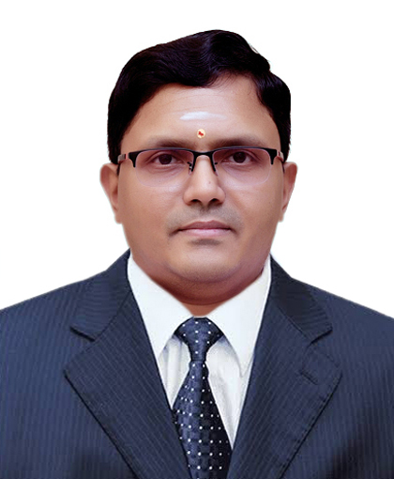

Profile :
Quality System Consultant (Independent Consultant) & Trainer equipped with over 25 years of experience in handling various disciplines of Quality in establishing Quality Management Systems, compliance to Regulatory inspections, Validation, Training, Data Integrity and Quality culture.
Global Exposure: Work experience in the pharmaceutical and vaccine industry with international regulatory standard such as USFDA, MHRA, EUGMP, TGA, MCC, ANVISA, PMDO- Japan, Danish Medical Agency, WHO – Geneva, PICs – Ukraine, FDA Ghana.
Industry Expertise: Injectable /Ophthalmic/Oral Solid Dosages / Oral Liquid Dosages/ APIs: Sterile-Non-Sterile | Vaccines.
Since March 2020, Quality System Consultant (Independent Consultant) & Technical Trainer , supporting global pharmaceutical / vaccine / medical devices manufacturing organization.
Professional Skills:
Quality System Assessment, Sterility Assurance, Microbiology Assurance, Media Fill Oversight, Failure Investigation, Data Integrity management, Quality culture development, Gap Assessment, Mock Audit, Remediation
- Injectable, API, Sterile APIs, OSD and Vaccines. Medical Devices
Certification:
CQI-IRCA Certified Lead Auditor in :
IS 9001 : 2015 (QMS)
IS 13485 : 2016 (Medical Device QMS)
Soft Skills:
Communication, Leadership, Team building, Innovation, Analytical, Active listening, continuous learning, Mentorship, Problem solving
Academic Details :
Madurai Kamaraj University, IND, 1998
M.Sc. in Microbiology
Credentials
Balaji K (Balaji Krishnan)
Email : sustainablequalitycompliance@gmail.com
Mobile : 9043287322

